Slide 1


PY-EXPO
2K24
Team ID: T114
Team Name: TECH SPARTANS
Genius innovation leaves behind a legacy...
PYEXPO 2K24

Slide 2
PS Code: PY190
Problem Statement : MEETING MINUTES EXTRATION FROM VIRTUAL MEETING
02
PYEXPO 2K24

Slide 3
Solution
Transcribing virtual meeting recordings into text can be accomplished with automatic transcription software. To extract judgments, action items, and important points, use natural language processing techniques. Sentiment analysis can be used to determine participants' responses. Schedule follow-ups by integrating with calendar systems. Make sure that security and data privacy are followed at every stage.
Technology Stack
FRONT-END : HTML , CSS , JSS
BACK-END : FLASK
DATABASE : PostgreSQL
03
PYEXPO 2K24

Slide 4
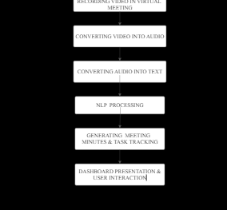
FLOW CHART
04
PYEXPO 2K24

Slide 5
Team Member Details:
TEAM LEADER : GOKUL HISHNA R
MEMBER 1 : AKASK K
MEMBER 2 : DEEKSHIT S
MEMBER 3 : PRAKADEESH J
05
PYEXPO 2K24

Slide 6

Thank You
Any Queries?
PYEXPO 2K24

